Slide 1
Mandated Reporting of Child Abuse and Neglect
August 2019

Slide 2
Procedures for Reporting Child Abuse/Neglect
It is the LEGAL OBLIGATION of all mandatory reporters to directly report suspected child abuse/neglect to the Department of Children and Family Services (DCFS) and/or local law enforcement agencies.
Key Terms
Legal Obligation
Mandatory Reporters
Direct Reporting
DCFS and/or local law enforcement

Slide 3
Legal Obligations
Legal requirements are delineated in
The Louisiana Children’s Code Article 603, 609, 610. . .
Louisiana Criminal Code (R.S. 14:403)
Caddo School Board Policy (JO-R – Student Records)
Purpose of the legal obligation
Facilitate the protection of our most vulnerable children
Safeguard school employees and their districts from serious consequences for noncompliance with the law

Slide 4
Mandatory Reporters
Defined in the Children’s Code (CHC 603)
“Teaching or child care provider” is any person who. . .
“Provides or assists in the teaching, training, and supervision of a child”
“Including any public or private teacher”
“Teacher’s aide”
“Instructional aide”
“School principal”
“School staff member”
“Bus driver”
“Coach”
“Or ANY individual who provides such services to a child in a VOLUNTARY or PROFESSIONAL capacity”

Slide 5
Direct Reporting
A report is a request for an investigation, not an accusation.
School staff with firsthand knowledge of suspected abuse/neglect must THEMSELVES immediately report to DCFS and/or law enforcement
School staff should not be made to report first to their principal, assistant principal, or other supervisory employee
“Second-hand” reporting by administrators
-cannot be accepted by DCTS
-violates mandatory reporters’ protection of confidentiality
-does not relieve school staff from their legal obligation to directly report

Slide 6
Direct Reporting
It is the individual responsibility as a mandatory reporter to ENSURE that a child abuse/neglect report is made.
Never assume that another professional or adult has already reported the situation to DCFS/law.
A report is a request for an investigation, not an accusation The mandated reporter should not confirm, verify or question the child’s disclosure.
If you suspect that abuse is happening again or continuing, re-report. Do not hesitate to make another report.
Dual Reporting (making a report to DCFS AND LAW enforcement) is permitted and encouraged, but not required. (Ch. C. Art. 610)
CPSB is working with SPD to DUALLY REPORT EVERY CASE. (can include reports to school based officers, Community Liaison Officers, patrol)
If there is a problem with Law Enforcement or DCFS receiving a report, contact counseling specialist or security department.
Make oral report and follow-up with a written report within 5 days.

Slide 7
Direct Reporting
When the child leaves school will he/she be in immediate risk of harm?
Are there visible signs of abuse or neglect?
Is the child involved in human sex trafficking or sexual abuse?
Is the child in an emergency situation that requires immediate assistance?
Is this a life-threatening injury?
Is it an emergency?
If YES to any of these questions, this is an EMERGENT report and you need to take the following steps immediately:
Call the HOTLINE IMMEDIATELY to report
DO NOT submit an on-line report to DCFS (only submit on-line if non-emergent)
Dually report to law enforcement
Remember, Caddo’s reporting form can be used to guide your DCFS hotline oral report and as the required follow-up written report to DCFS.

Slide 8
Failure to Directly Report
Failure of mandatory reporters to directly report to DCFS and/or law enforcement can result in fines and imprisonment
Louisiana Criminal Code (R.S. 14:403)
Any person required to make a report of child abuse who knowingly and willingly fails to do so will be (failure to report)
- guilty of a misdemeanor
- upon conviction will be imprisoned up to 6 months
- fined up to $500
- or both
Any person who is required to report the sexual abuse of a child, or the abuse or neglect of a child which results in the serious bodily injury, neurological impairment, or death of the child, and knowingly and willfully fails to so report will be (failure to report with serious injury, etc.)
- Guilty of a felony
- imprisoned up to 3 years
- Fined up to $3000
- Or both

Slide 9
Failure to Directly Report
Louisiana Criminal Code (R.S. 14:403) cont’d. . .
Any school employee who “knowingly and willfully obstructs the procedures for receiving and investigating reports of child abuse or neglect or sexual abuse,”
- guilty of a misdemeanor
- upon conviction shall be fined not more than $500
- imprisoned not more than 6 months
- or both

Slide 10
Scenario 1
At the beginning of the school day, a student tells his classroom teacher about abuse. The teacher is required to tell the principal who makes the determination of whether or not to report to DCFS and/or law enforcement. During her lunch, the teacher goes to the principal to tell of the suspected abuse. Teacher with first-hand knowledge does not make report, but the principal does.
Are there any problems with this scenario?

Slide 11
Scenario 1 continued
At the beginning of the school day, a student tells his classroom teacher about abuse. The teacher is required to tell the principal who makes the determination of whether or not to report to DCFS and/or law enforcement. During her lunch, the teacher goes to the principal to tell of the suspected abuse. Teacher with first-hand knowledge does not make report, but the principal does.
Are there any problems with this scenario? YES
Teacher with 1st hand knowledge needs to make the report immediately (not later).
Telling the principal does not relieve the teacher of his/her mandated reporting responsibility, even if the principal makes the report.
A staff member cannot be required to report to the principal first, so the principal can make the determination. It is still important to let administration know what is occurring on campus.
It is permissible to complete the report together. Some teachers may want/need help in completing the report.

Slide 12
Scenario 2
A teacher tells the school counselor that one of her students came to school with burn marks on his arm the day after the teacher called his parent about his misbehavior in class.
What steps does the school counselor need to take?

Slide 13
Scenario 2
A teacher tells the school counselor that one of her students came to school with cigarette burn marks on his arm after the teacher called his parent about his misbehavior in class. The teacher asked the child what happened and he did not want to talk about the situation.
What steps does the school counselor need to take?
School staff with FIRSTHAND knowledge of SUSPECTED abuse must themselves IMMEDIATELY REPORT to DCFS and LAW ENFORCEMENT.
Teacher has firsthand knowledge, so she makes the report.
The report needs to be made immediately to DCFS AND Law Enforcement.
Counselor can assist the teacher in making the report if the teacher needs/wants help.
If you complete the form first, you will have all the needed information when you make the call.
Follow-up with written report.

Slide 14
Caddo’s Reporting Form
CPSB’s reporting form
Revised 8/01/2019 - FILLABLE
Use Caddo form to make oral and written report
Is aligned with Louisiana Law and CPSB Policy
Is more detailed than the state reporting form
Follows the questions asked by the child protection intake worker
Documents reporting procedures
Includes reminders and resource numbers
A report is a request for an investigation, not an accusation.

Slide 15
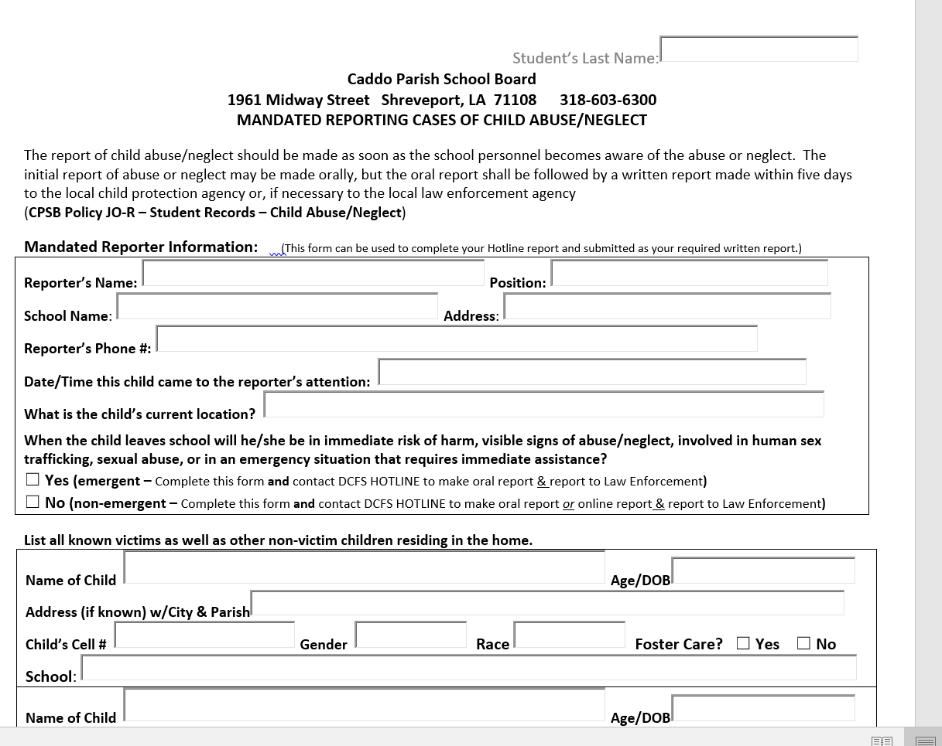

Slide 17
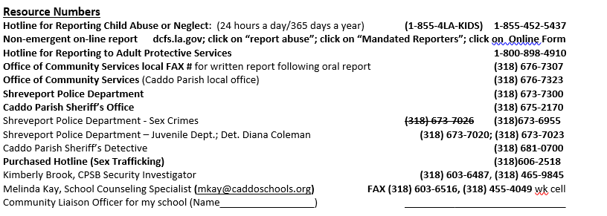

Slide 18
Things to remember
A report is a request for investigation, not an accusation.
Mandated Reporting Form is on CPSB website (upper right corner click on FORMS; search Mandated Reporting)
It is the individual responsibility of the mandatory reporter to ENSURE that a child abuse/neglect report is made.
Report IMMEDIATELY.
If you have made previous reports, have that information available and let the intake worker know.
Make oral report and follow-up with a written report within 5 days (use CPSB form to streamline the process)
Coordinate with people on campus who “need to know”.
Dual Report
Child Protection AND
Law Enforcement
On-campus Law Enforcement Officer (SRO, SLO)
Community Liaison Officer (CLO)
Patrol

